Slide 1
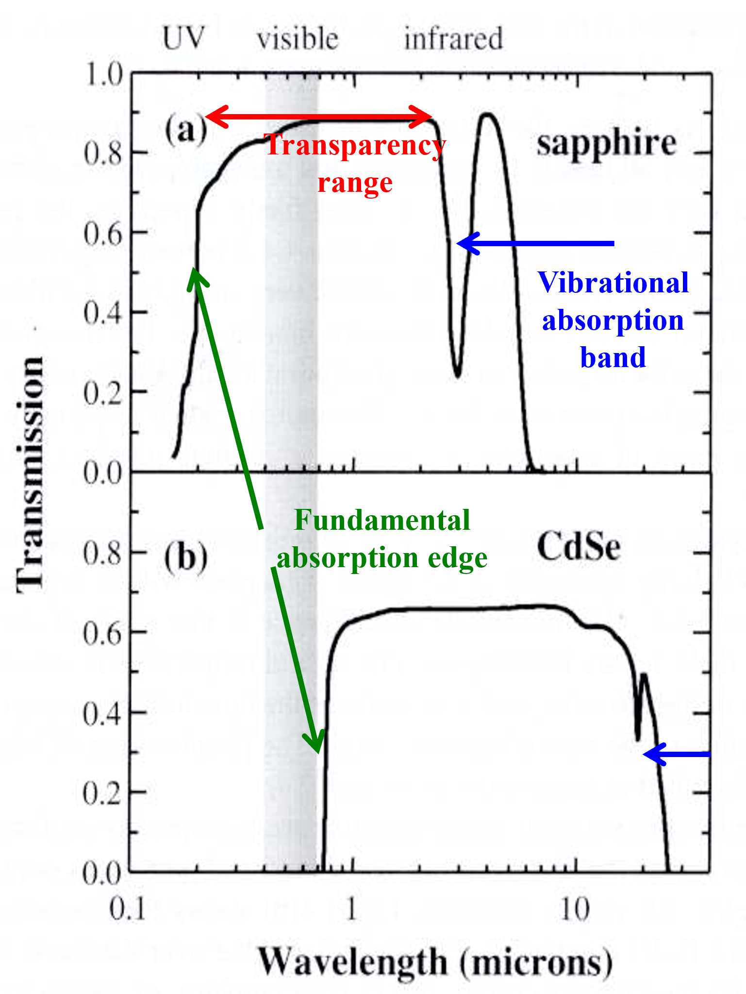
Optical properties of materials - introduction
Chapter 4
Crystalline Insulators
(bandgap >4 eV by convention)
The transmission spectrum for sapphire (Al₂O₃) shows the features typical of insulators and semiconductors.
There is high transmission in the transparency range of the crystal and lies in the bandgap, here in the wavelength range 0.2-6.0 μm.
Hence, sapphire is colourless and transparent to the eye.

Slide 2
Chapter 4
The transparency drops sharply in the UV for λ < 0.2 μm due to absorption by bound electrons).
The dip in the transmission at ~3 μm, and the sharp drop in transmission for λ > 6 μm, is caused by vibrational absorption and is not related to the electronic band structure.

Slide 3
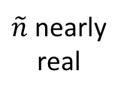
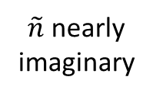
Chapter 4
Main point:
Fundamental absorption edge arises from absorption from conduction band to valence band.
$\tilde{n}$ nearly
imaginary
$\tilde{n}$ nearly
real

Slide 4
Chapter 4
Some crystalline insulators
at 546 nm

Slide 5
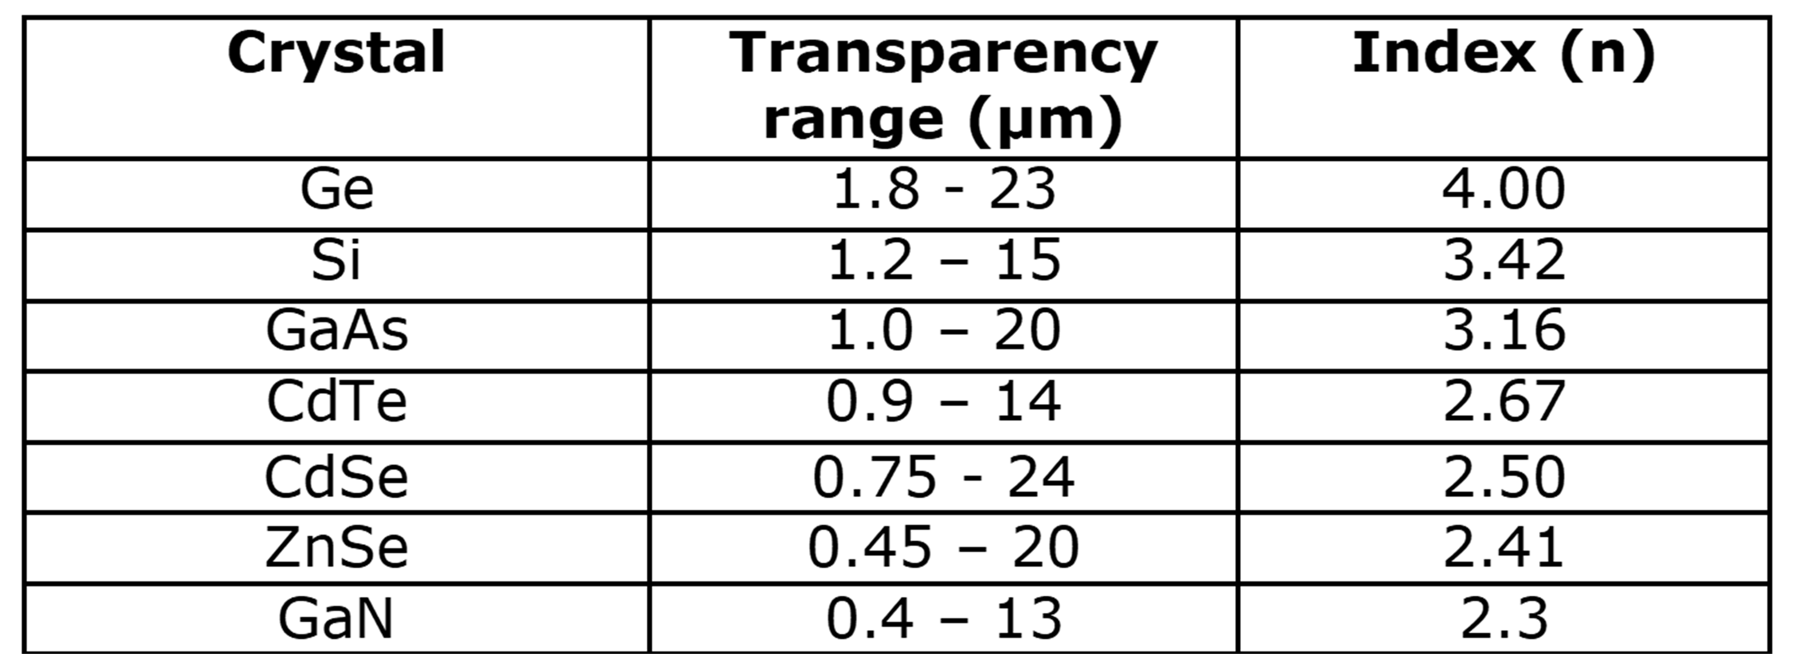
Chapter 4
Some crystalline semiconductors
at 10 µm
Note the correlation between the short wavelength limit of the transparency range and the refractive index

Slide 6
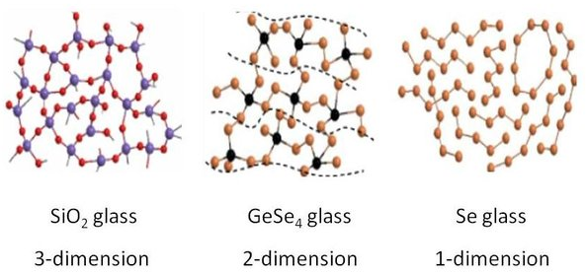
Chapter 4
Glasses
Most glasses are made by fusing sand (silica: SiO₂) with other chemicals (choice determines refractive index and dispersion). They exhibit optical properties of typical insulators but are not crystalline.
As an amorphous solid, the atomic structure of glass lacks any long range translational periodicity.
However, the local chemical bonding constrains the possible atomic positions so that glasses do possess a high degree of short-range order. In silica there is a tetrahedral arrangement of oxygen atoms around the silicon atoms

Slide 7
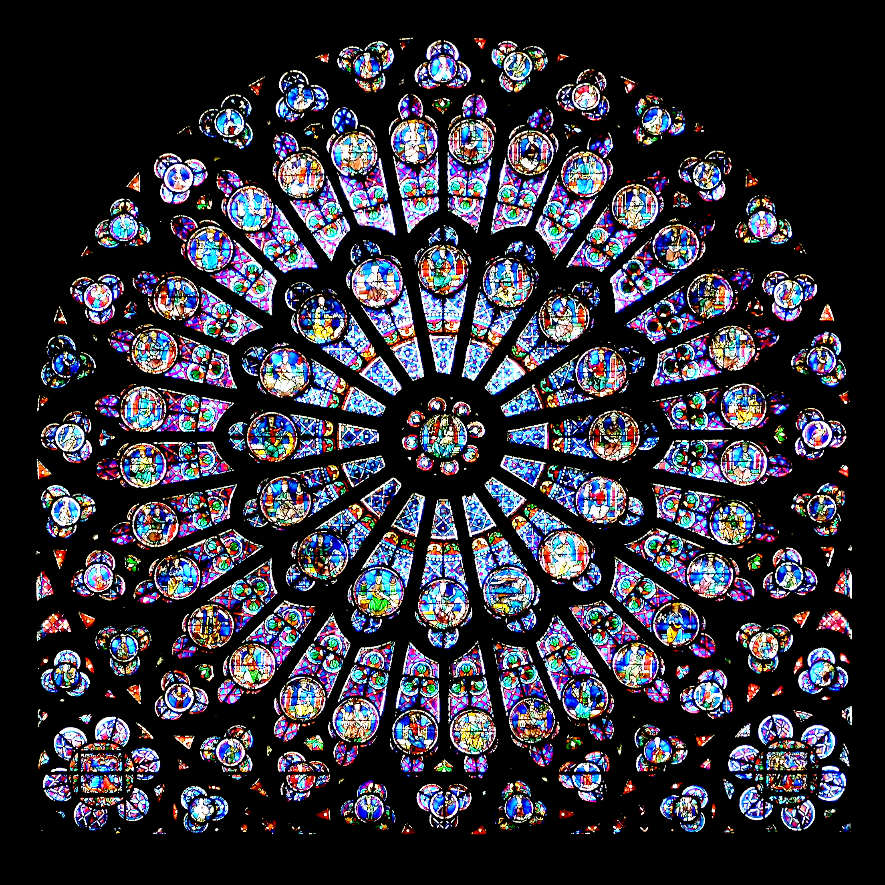
Chapter 4
Doped glasses and crystalline insulators
Coloured glass filters and stained glass are made by the addition of semiconductors and other dopants.
Colour control by:
Varying the composition of the dopant. e.g. an alloy semiconductor, like Cd_{x}Zn_{1-x}Se where the bandgap is tuned by x.
(b) Changing the size of semiconductor crystallites (quantum dots) within the glass. Quantum size effects occur when crystallite size is comparable to electron wavelength and change the bandgap.
Notre-Dame de Paris rose window

Slide 8
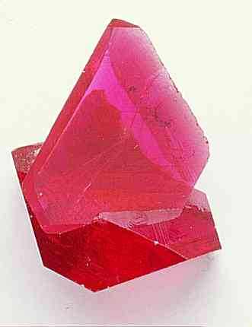
Chapter 4
Transition metal and rare earth ions are used extensively to dope glasses and insulating crystals for solid state lasers. Transition metals also give colour to gemstones. The discrete optical transitions of isolated atoms are broadened to give absorption bands.
Ti-doped
sapphire
Ruby: Al₂O₃ with 0.05% Cr³⁺ - appears
red because absorbs in blue and yellow/green

Slide 9
Chapter 4
Metals
Metals have a high reflectivity in the visible, below a characteristic frequency called the plasma frequency, due to interaction of light with free electrons.
For silver, the reflectivity is close to 100% in the infrared.
The reflectivity starts to fall in the visible spectrum where interband transitions (responsible for metal colour) occur and drops sharply in the ultraviolet – where metals are transparent.
Reflectivity of silver from the infrared to the ultraviolet. [Fox, fig. 1.5]

Slide 10
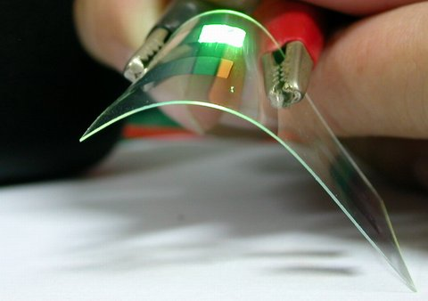
Molecular materials
Chapter 4
Organic compounds (those based on C-C bonds) can be crystalline or
amorphous. Covalent bonds within molecules are strong but molecules
are bonded to each other by weak van der Waal’s forces so that optical
properties of molecular solids are similar to those of constituent molecules.
Electronic and vibrational states are strongly
localised on molecules and strongly coupled
to each other.
Organic materials can be classified as
saturated : valence electrons form strong localised bonds between atoms;
conjugated: bonding is based on delocalized orbitals spread over whole molecule; weaker.
Organic light emitting diode

Slide 11
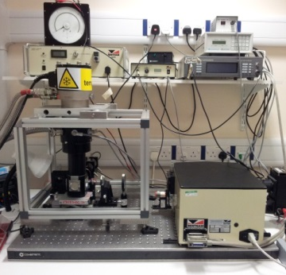
Photoluminescence (PL)
Chapter 4
Semiconductor picture: recombination of conduction band (CB) electron with valence band (VB) hole.
So, would expect energy of PL to be that of the (direct) band gap E_{G} (as measured by absorption measurements).
In fact, in crystalline semiconductors, photon emission at E_{G} is quite rare: often, free electrons and holes relax into (i) excitonic or (ii) defect or impurity-related states more quickly than any direct recombination process. These emit light at lower energies.
Notes:
Semiconductor picture vs molecular picture; intrinsic versus defect

Slide 12
Chapter 4
Excitons
Excitons are electron-hole pairs bound by Coulomb attraction – similar to
a hydrogen atom with swap of proton for hole: different reduced mass μ and also ε.
Band-edge optical properties can be dominated by excitons in 2 dimensional materials (because ε is very small) and ones with large μ (so having flat bands).
3D semiconductors
Insulators(e.g. alkali halides)
Molecular crystals
Small µ
Large ε_{r}
Large µ
Small ε_{r}

Slide 13
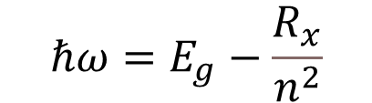
Chapter 4
Exciton features in absorption
n=1
$$ℏω=E_{g}−\frac{R_{x}}{n^{2}}$$
GaAs
E_{g} =1.425 eV
R_{X} = 4.2 meV

Slide 14
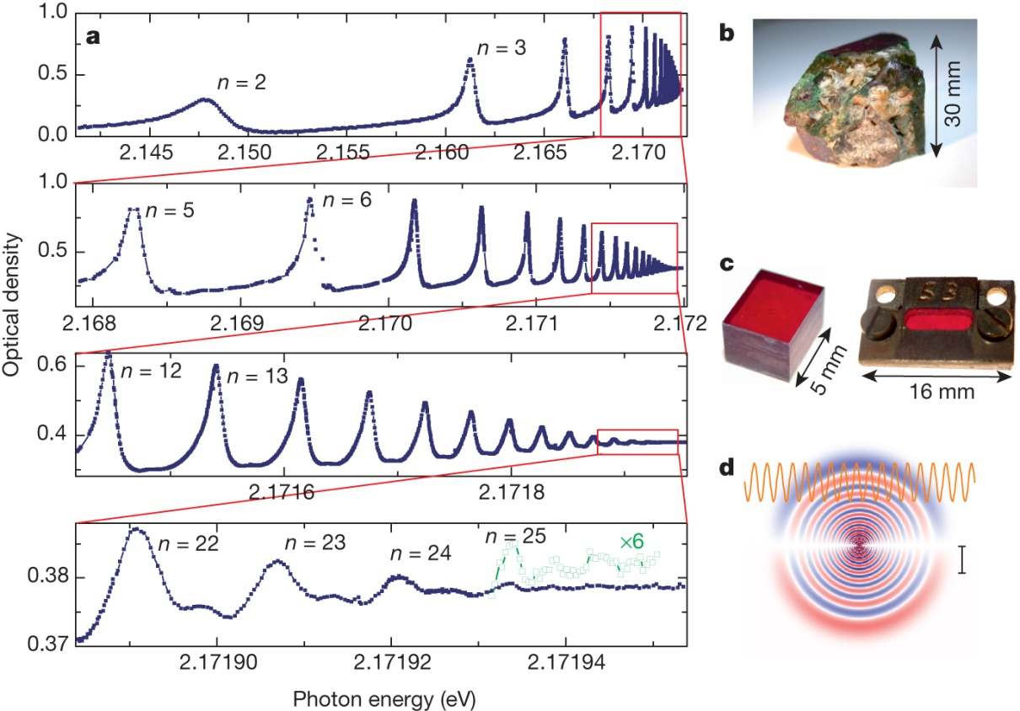
Chapter 4
High-resolution absorption spectra of excitons in Cu₂O.
T Kazimierczuk et al. Nature 514, 343-347 (2014) doi:10.1038/nature13832

Slide 15
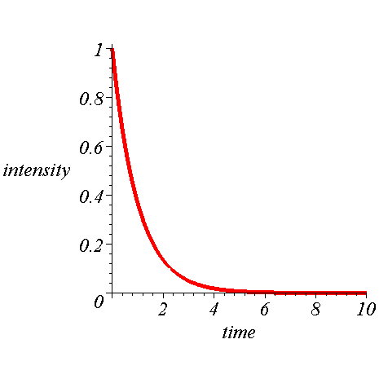
PL basics (1)
Chapter 4
Energy
g
n
τ
g = generation rate
τ = lifetime

Slide 16
PL basics (2)
Chapter 4
g
n
A
τ_{ΝR}
τ_{R}
B
Radiative and non-radiative lifetimes are often strongly dependent on temperature. Temperature also affects re-excitation from B back to A.
R = radiative
NR = non-radiative

Slide 17
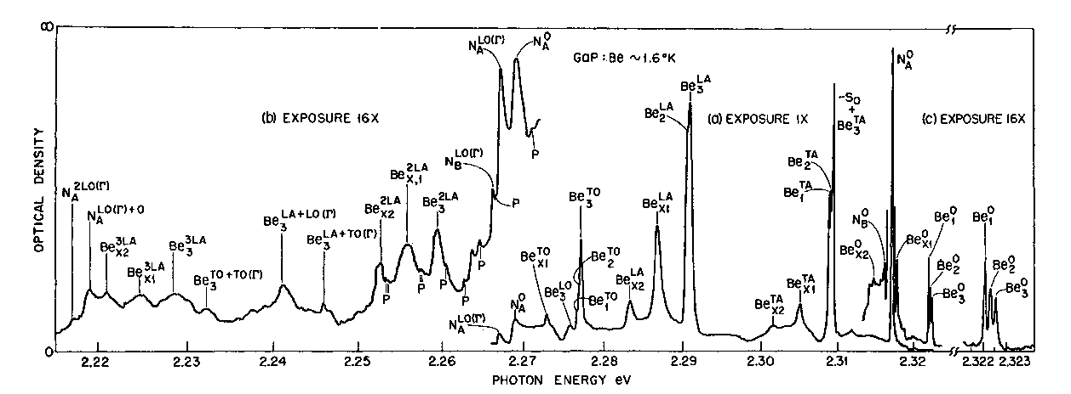
Chapter 4
Exciton and impurity-bound exciton features in emission
Excitons can themselves bind to impurities (donors, acceptors) especially at low temperatures; analogous to H₂.
These spectra show the PL of GaP doped with Zn (top) and Be (bottom)
(Dean et al., 1971)
PJ Dean et al, PRB 4 (1971) 1926

